Slide 1
An Introduction to Blockchain Development
MICS 2022

Slide 2
Who Am I
Computer Science at MSOE
Blockchain exploration at Rockwell Automation
Undergraduate blockchain course
Notes:
At Rockwell:
Read countless papers on applying blockchains
Interviewed managers in various departments about their current and future problems to determine if blockchain could be used as a solution
Worked on the applications for two patents regarding blockchain

Slide 3


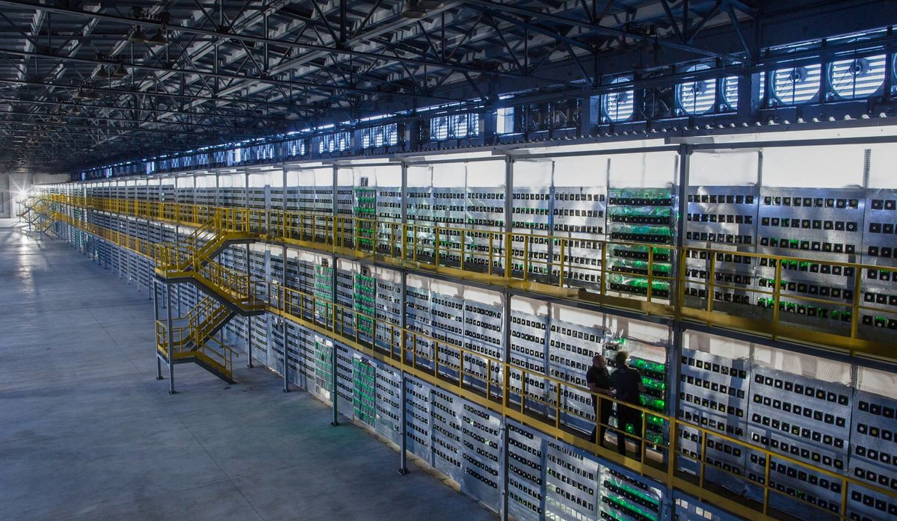
Why Blockchain
A controversial topic
Short-term issues
Blockchain is the next Cloud
Notes:
If you’ve been on twitter any time in the last year, it’s nearly impossible to avoid seeing the daily battles between the climate activists and the users with the ape profile pictures who have likely over invested into NFTs
Proof of stake (won’t get into)
Next cloud, both literally and figuratively
10 years, not having experience with cloud technologies was not a big deal for senior developers, the same thing can be said for blockchain today

Slide 4

How It Works
A distributed digital ledger
An immutable linked list
An application layer protocol

Slide 5
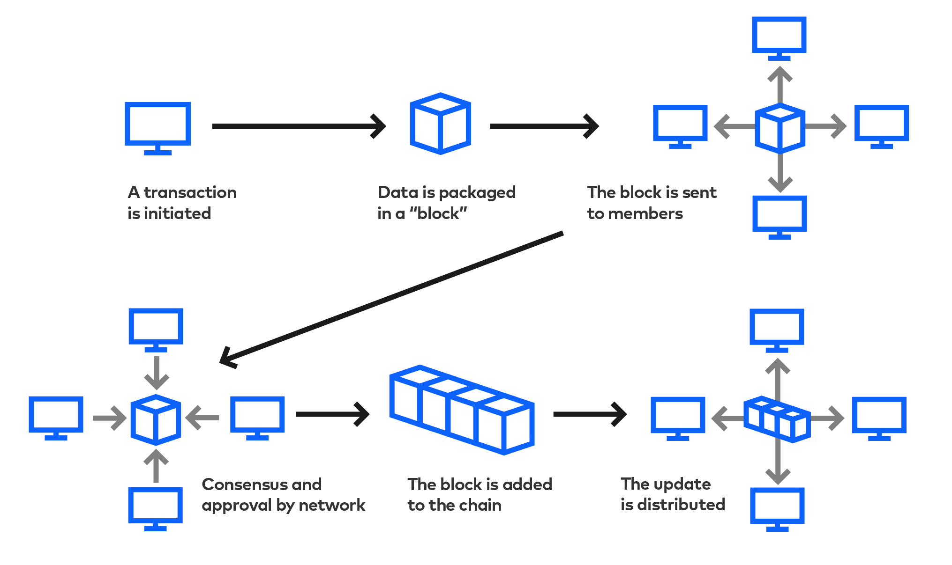
How It Works

Slide 6
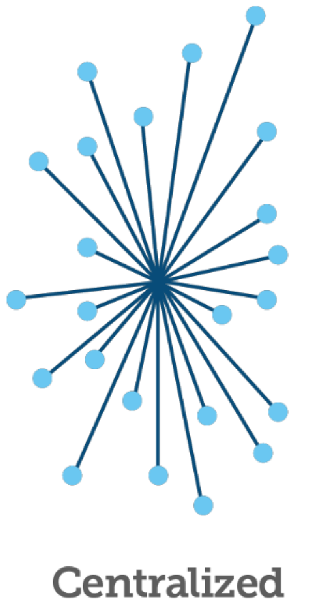
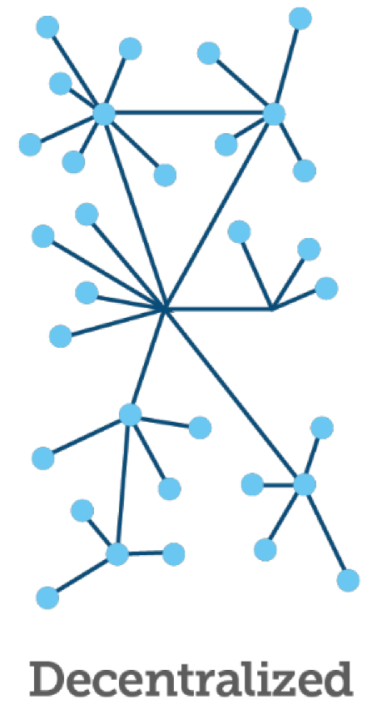
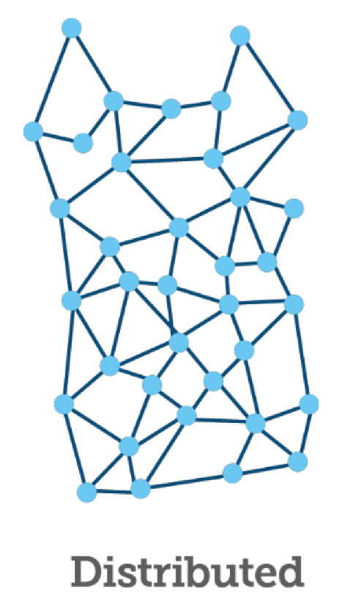
How It Works

Slide 7
Smart Contracts
Files of code (Solidity, Rust, C++, Python)
Stored and executed on the blockchain
Transparent and trustless

Slide 8
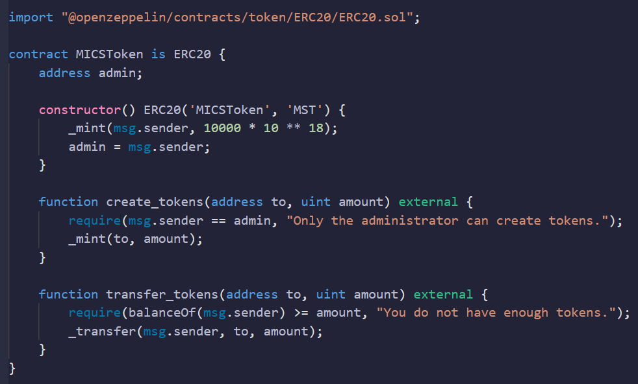
Smart Contract Example
Written in Solidity
Follows ERC20 Standard
Initial supply of 10,000
18 decimal places

Slide 9
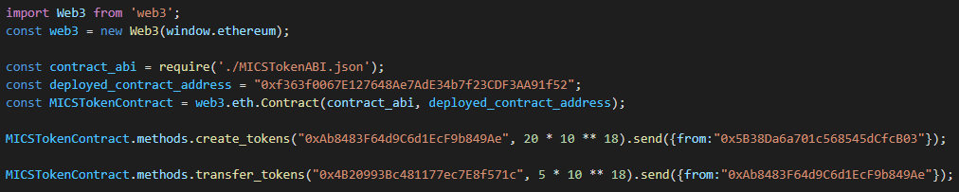
dApp Example
‘Decentralized Application’
Smart contract backend

Slide 10
DAOs
‘Decentralized Autonomous Organizations’
The entrepreneurial engineer’s best friend
Solve a need
-> stake claim
-> DAO
-> profit
Notes:
“If you consider yourself entrepreneurial, this is arguably the most important slide in this presentation”

Slide 11
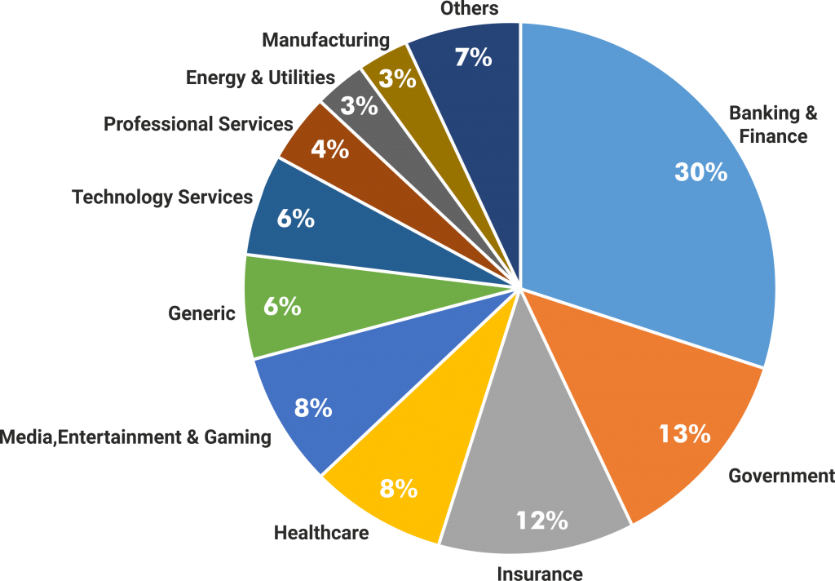
Existing DAOs
Lofty.ai
Tokenized real-estate
Exonum
Digital document verification
Chronicled
IoT supply chain tracking

Slide 12
Going Forward
Idea space is still vastly unexplored
Sets developers ahead of competition
Solve previously impossible problems

Slide 13
Questions

Slide 14
Resources

